Slide 1
9245-SAP-Insider-Campaign-Creative-Ads-statics
9202-01-Newsletter-ad
Copy: Transform your operations with SAP Signavio, Microsoft Azure and Fujitsu
Find out how

Slide 2
9245-SAP-Insider-Campaign-Creative-Ads-statics
9202-08-Category-leader-ad
Copy: Increase your profits by minimizing errors, fraud, and theft
Find out how

Slide 3
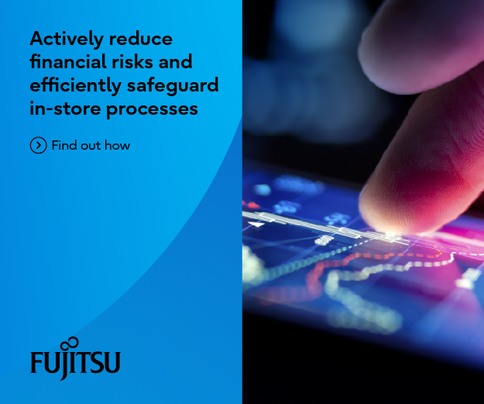
9245-SAP-Insider-Campaign-Creative-Ads-statics
9202-09-Industry-leader-ad
Copy: Actively reduce financial risks and efficiently safeguard in-store processes
Find out how

Slide 4
9245-SAP-Insider-Campaign-Creative-Ads-statics
9202-10-Website-leader-ad
Copy: Super-powering your factory transformation
Smart manufacturing solutions for a sustainable future

