Slide 1
Email signature

Slide 2
John
Animated
Static

Slide 3
Static ‘question mark’ image for landing page
2900x575

Slide 4
Static ‘cheering’ image for landing page
2900x575

Slide 5
Animated ‘question mark’ image for landing page
2900x575

Slide 6
Animated ‘cheering’ image for landing page
2900x575

Slide 7
Mouse pad
Option 1: Cloud mouse pad
Option 2: Mouse pad with ‘cloud’ padding

Slide 8
Laptop stickers
3in x 3in

Slide 9
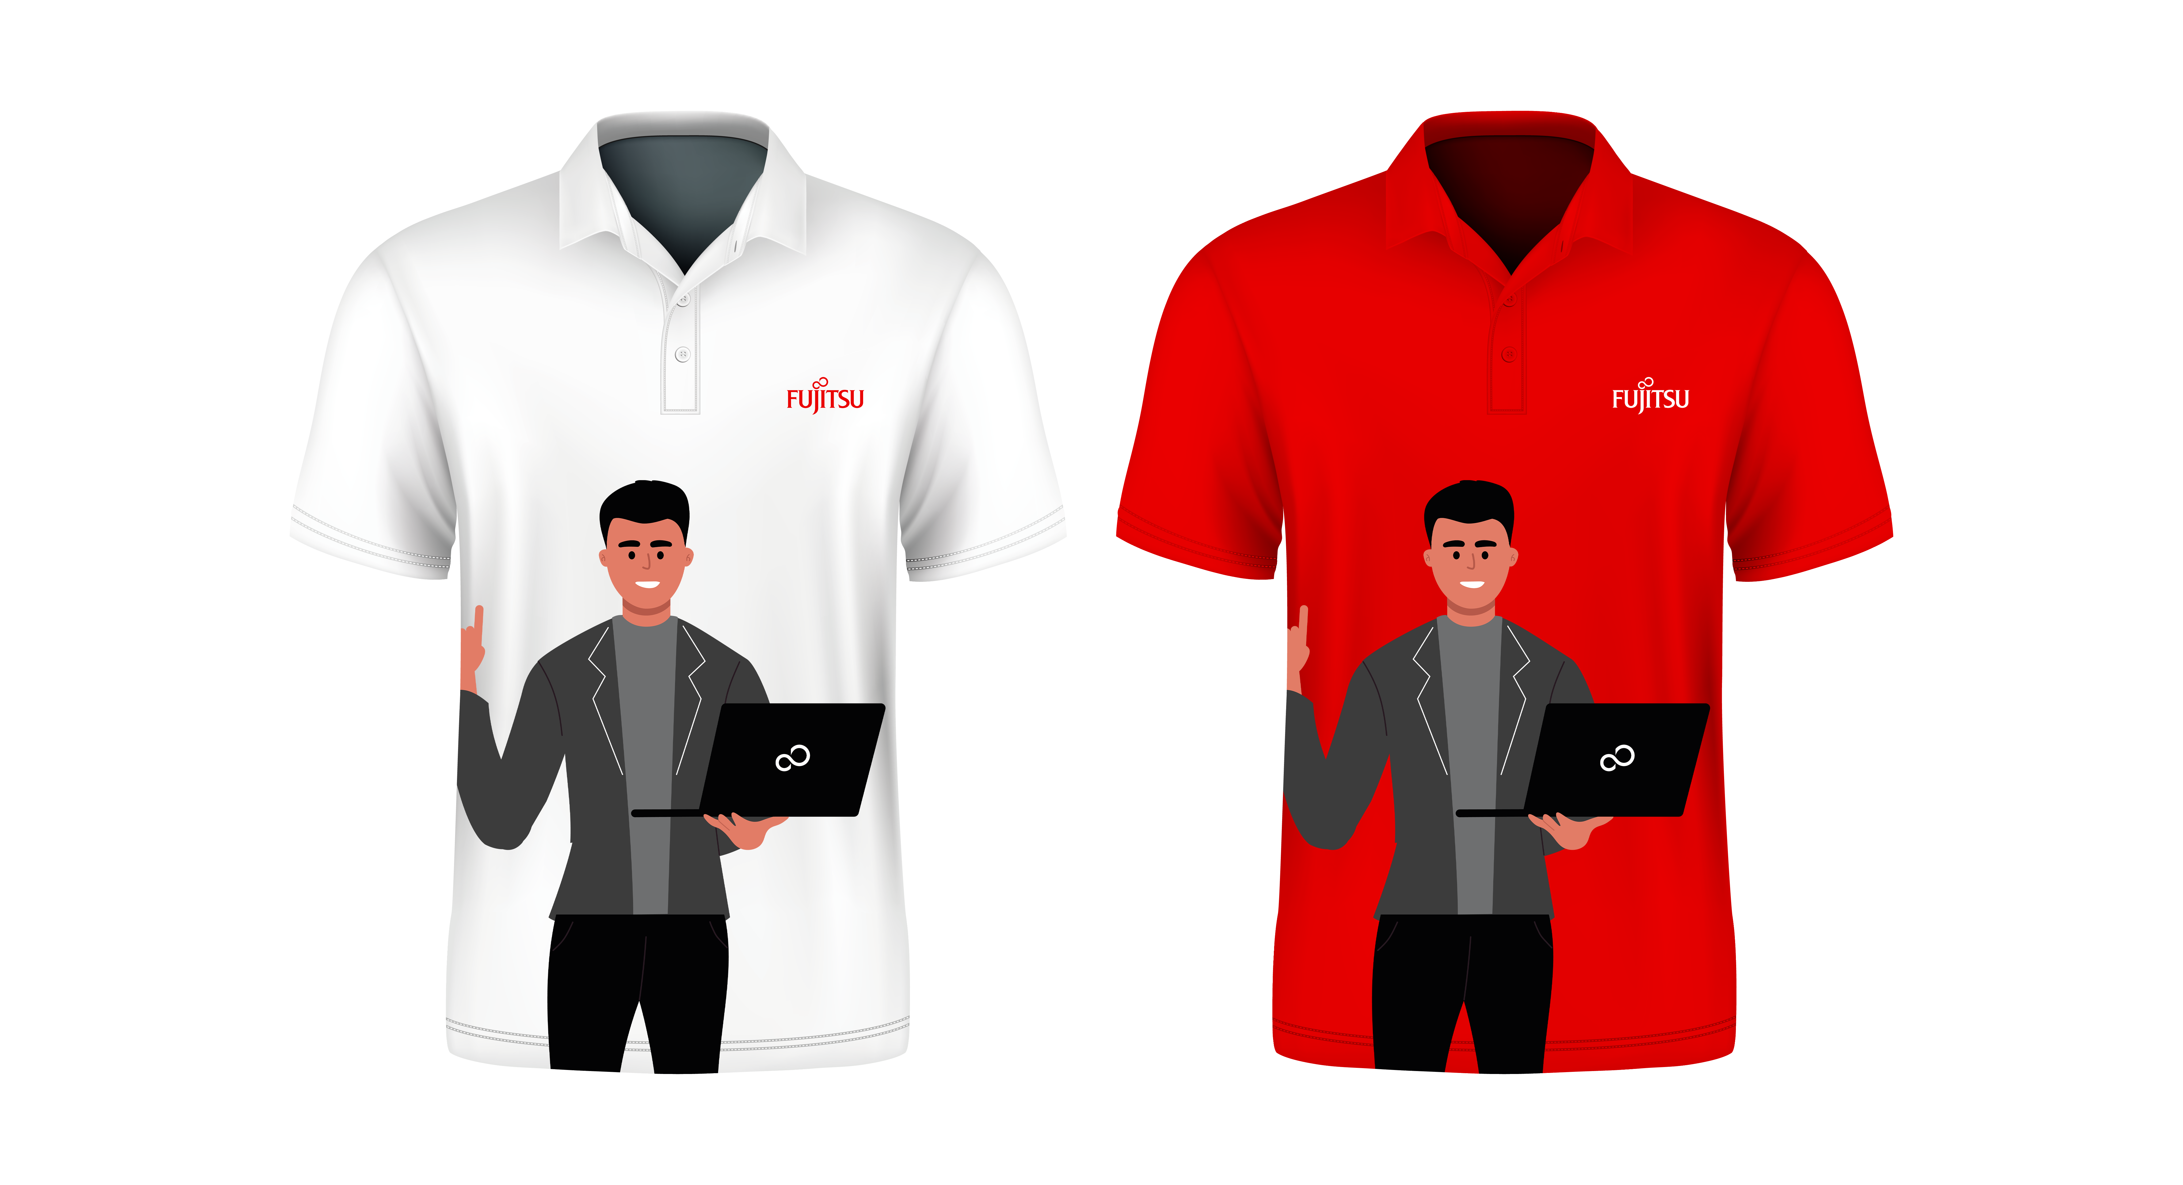
Shirts

